Slide 1



MCA 4th sem,
Department of CS&IT
Cotton University, Guwahati-01
InfluenceConnect
Uniting Social Media Influencers
& Businesses
Presented by-
Shankhanad Choudhury
MCA2265040
MCA 4th semester
Under the Guidance of
Mr. Melur Phangcho,
Assistant Professor,
Cotton University, Guwahati

Slide 2


Introduction
InfluenceConnect acts as a bridge between the world of social media influencers and the strategic needs of businesses. It streamlines the often-complex process of influencer marketing by creating a centralized platform for collaboration.
Businesses can leverage InfluenceConnect to identify influencers whose target audience aligns perfectly with their brand. Influencers, on the other hand, gain valuable exposure and partnership opportunities with credible brands.
This mutually beneficial ecosystem fosters innovative marketing campaigns that resonate with target audiences and propel both businesses and influencers forward in the ever-evolving digital landscape.

Slide 3





Key Features
Influencers can showcase their niche, reach, and previous collaborations
Businesses can post their marketing needs and budget
Secure communication between influencers and businesses
Building trust and
credibility within the
platform
Secure transactions services

Slide 4

How it works
BUSINESSES:
Sign up and create a Campaign listing
Specify their target audience, goals, and budget
Browse influencer profiles and invite relevant ones to collaborate
INFLUENCERS:
Create a profile highlighting their expertise and audience
Search for projects that
align with their niche and interests
Send proposals and negotiate terms with businesses

Slide 5

The Power of Social Media Influencers
Social media influencers with a substantial online following hold immense sway over their audience's purchasing decisions. Influencers create authentic connections with their audience, leading to higher conversion rates.

Slide 6


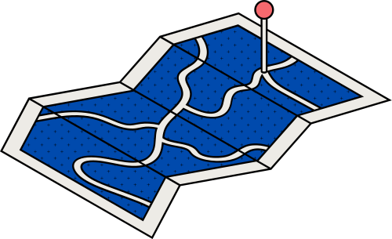
Why Influencer Marketing Matters?
Unlike traditional advertising, influencer marketing feels more genuine and relatable.
It taps into niche markets that might be challenging to target otherwise.
Provides an opportunity for businesses to leverage the trust influencers have built with their followers.

Slide 7
HARDWARE REQUIREMENTS
The online website requires minimal hardware requirements. The following configuration is required for a PC to use the web app without any performance issues:
Processor: Quad-core or better CPU by AMD or Intel
RAM: 4 GB RAM or more
Storage: 256 GB or higher
Other: An active internet connection
SOFTWARE REQUIREMENTS
This section lists the requirements that are needed to run the system efficiently. The operating system needed for the system to run effectively and the interface to run the application are as follows:
Operating System: Windows 8 or newer, Linux all major distributions, macOS Sierra or newer
Web Browser: Any modern browsers

Slide 8


System Design
Flowchart
Data flow Diagram

Slide 9
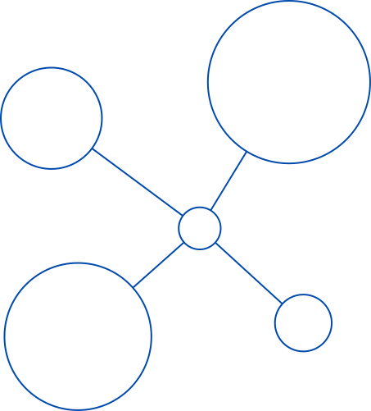
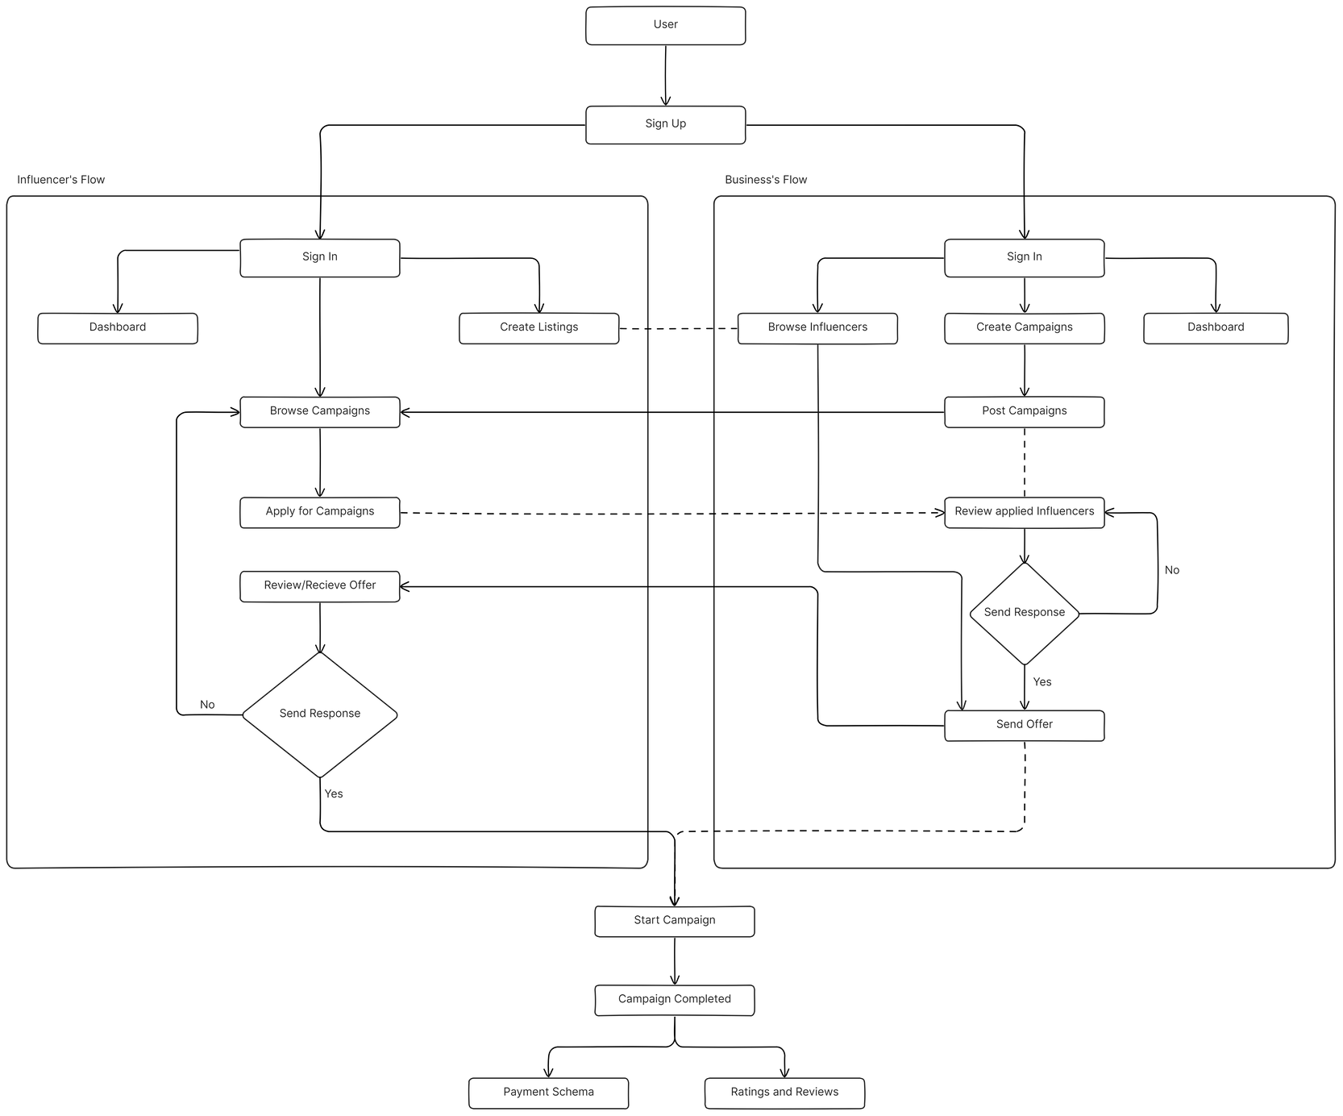
FlowChart

Slide 10
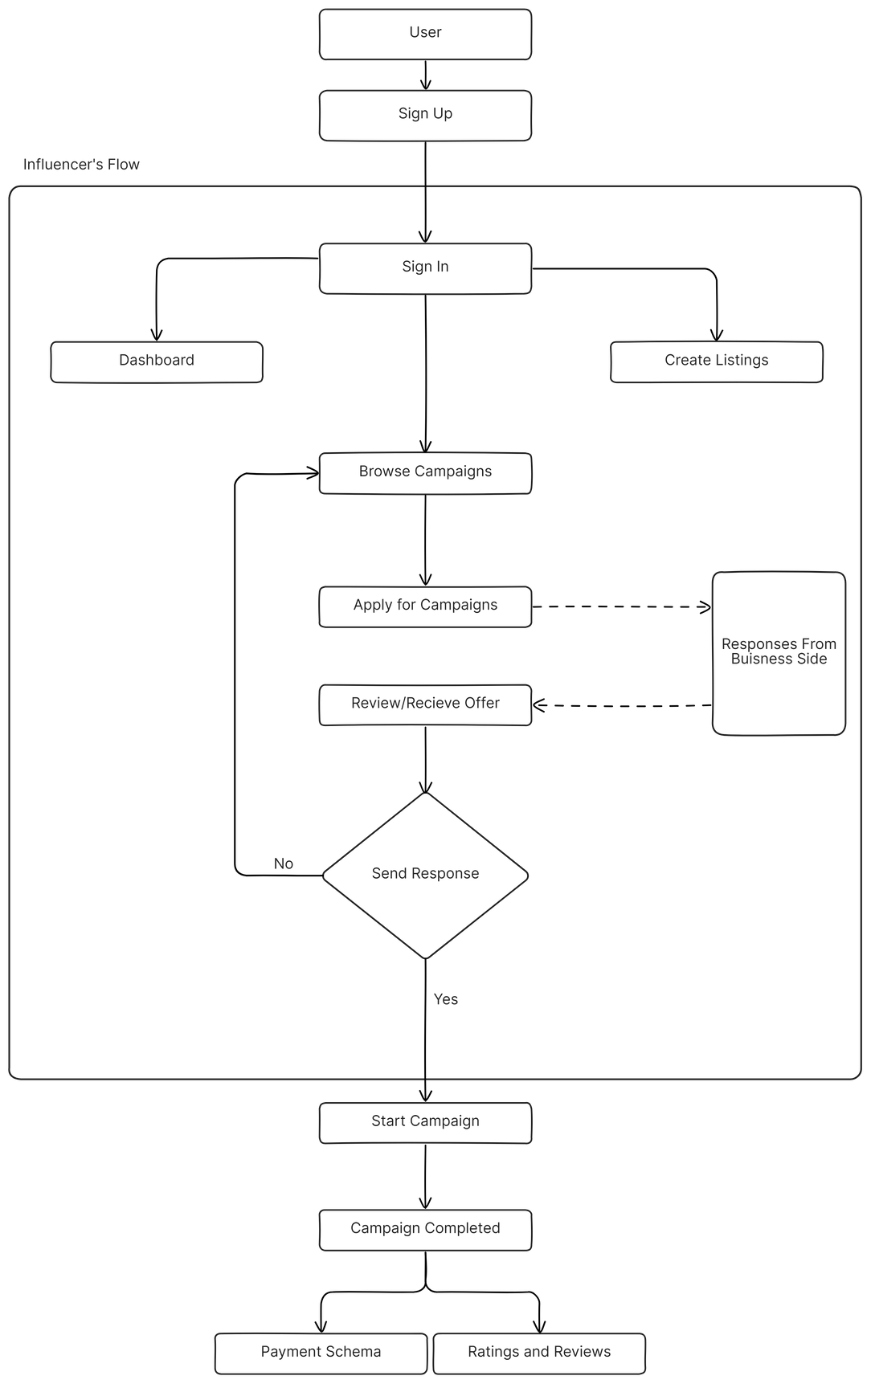
Influencer’s Flow
in
InfluenceConnect

Slide 11

Business’s Flow
in
InfluenceConnect

Slide 12
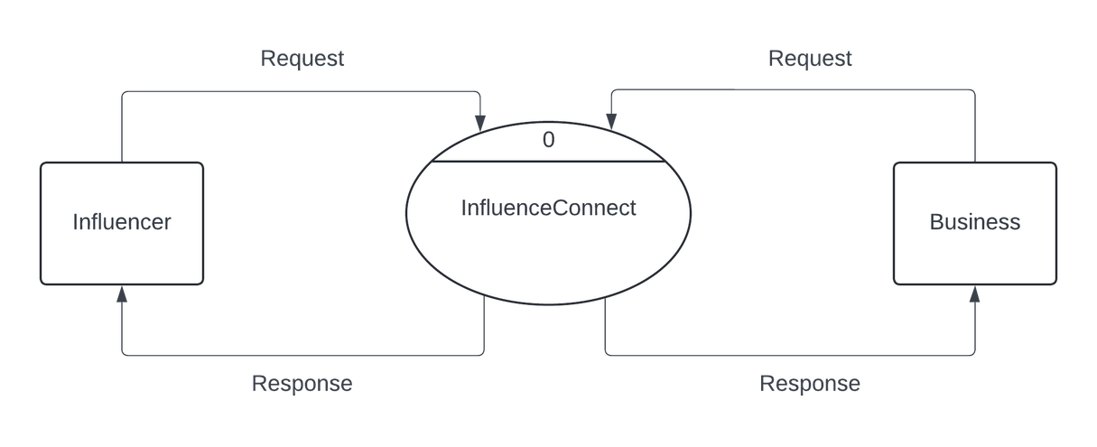
Context Level
DFD

Slide 13

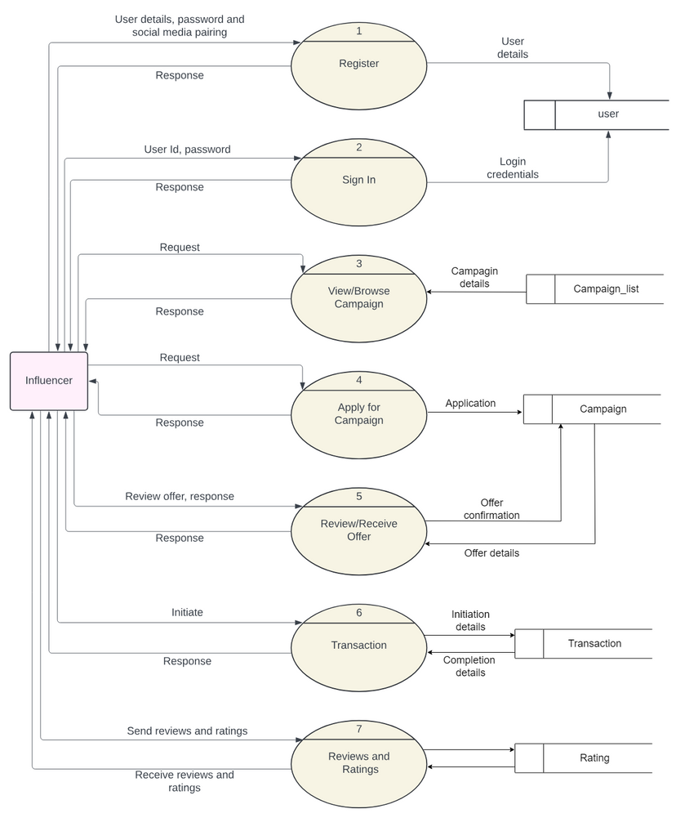
DFD Level 1
for Influencer’s

Slide 14
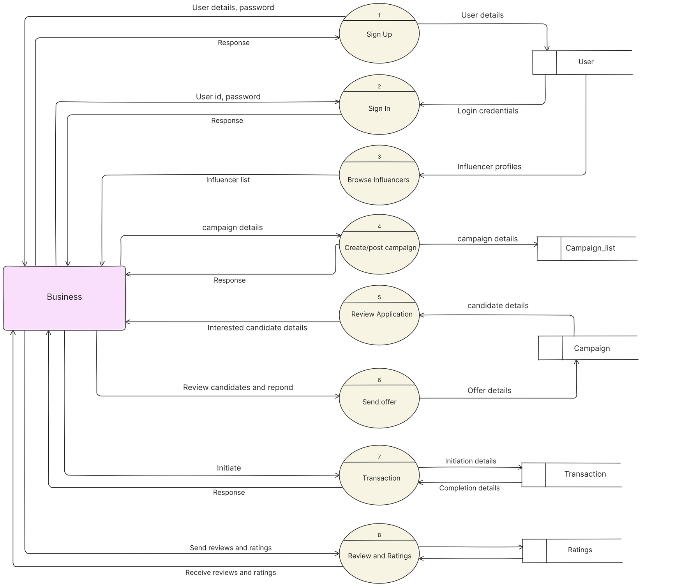
DFD Level 1
for Business’s

Slide 15
Features of InfluenceConnect like the rating system would be limited due to the fact that some social media platforms don’t allow public access to its APIs or are paid. A way around these limitations would be to create a mock database similar to that to showcase the functionality of the application.
Limitations

Slide 16
Conclusion
The InfluenceConnect platform revolutionizes influencer marketing by providing a seamless, transparent, and efficient way for businesses to connect with influencers and launch impactful marketing campaigns. By facilitating authentic collaborations, InfluenceConnect empowers both influencers and businesses to harness the power of social media for mutual growth and success.

Slide 17

Thank you.

